Slide 1


EXPLORATORY DATA ANALYSIS COURSE PROJECT
LEADING
INDUSTRIES
Analyze a dataset of leading industries .
-Ashlesha Khanapure

Slide 2
Contents
●Problem Statement
●Introduction
●Objectives
●Dataset Overview
●Functional Requirements
●Non-Functional Requirements
●References

Slide 3
Problem Statement
Problem Statement : Analyze a dataset of leading industries .
Goal : Gain insights into the leading industries dataset and identify key patterns, trends, and relationships within the data.
Provide meaningful visualizations, summary statistics, and key insights that can guide decision-making processes.

Slide 4
Introduction
In this EDA project, we delve into a leading industries dataset to track the performance of different industries over time. This data can be used to identify emerging industries, track the growth of existing industries, and understand the factors that drive industry success. The leading industries dataset is a valuable resource for businesses that are looking to identify new opportunities for growth and to make strategic decisions about their products and services.

Slide 5
Objectives
Clean and prepare data for analysis.
Explore and visualize trends and patterns.
Analyze industry performance.
Identify leading and lagging Industries.
Investigate correlations between variables.
Provide insights and recommendations.
Present findings in a clear and concise manner.
Inform decision-making processes.

Slide 6
Dataset Overview
● Dataset has 321 rows and 10 columns.
● All values are non-null.
● Dataset Shape: (321,10).
○ 321 : Rows
○ 10 : Columns (Attributes)
● CSV File Size : Leading_Industries.csv (32.8KB)
● Data Types : int64(2), float64(3), object(5).

Slide 7
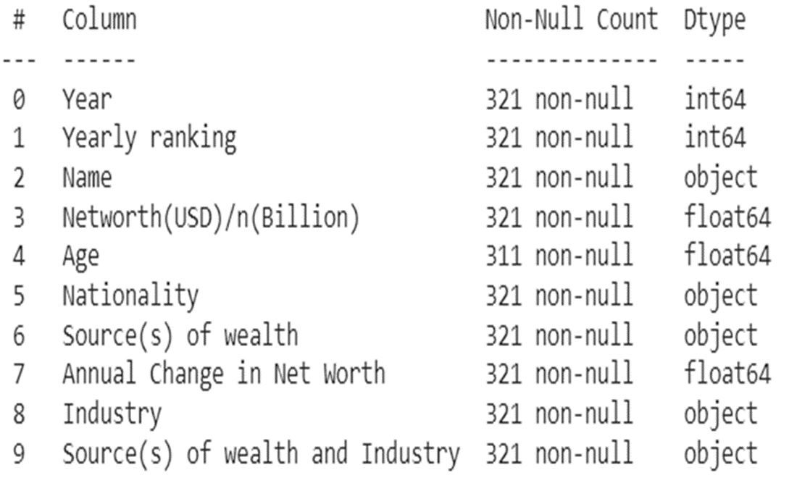
Attributes

Slide 8
Functional Requirements
Data Loading : Import the leading industries dataset from a specified source.
Data Cleaning : Handle missing values in the dataset by either imputing them or removing rows/columns.
Descriptive Statistics : Calculate and present key summary statistics such as mean, median, standard deviation, quartiles, and counts for each variable.
Visualization : Generate visualizations to explore relationships, trends, and patterns in the data.

Slide 9
Non-Functional Requirements
Efficiency: Ensure that data processing and analysis operations are performed efficiently, minimizing computation time and resource usage.
Accuracy: Ensure the accuracy and reliability of data cleaning processes, calculations, and analysis methods.
Interpretability: Make the analysis results and insights easily interpretable. Use meaningful labels, titles, and annotations in visualizations.
Documentation: Clearly describe the steps followed in data cleaning, analysis, and visualization. Document the interpretation of results, insights gained, and recommendations provided.

Slide 10
Data Preprocessing

Slide 11
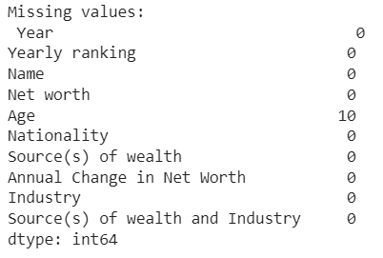
Data Cleaning
1.Removing of NULL values by removing the tuples.
2.No duplicates found in the dataset.

Slide 12
Data Visualization

Slide 13
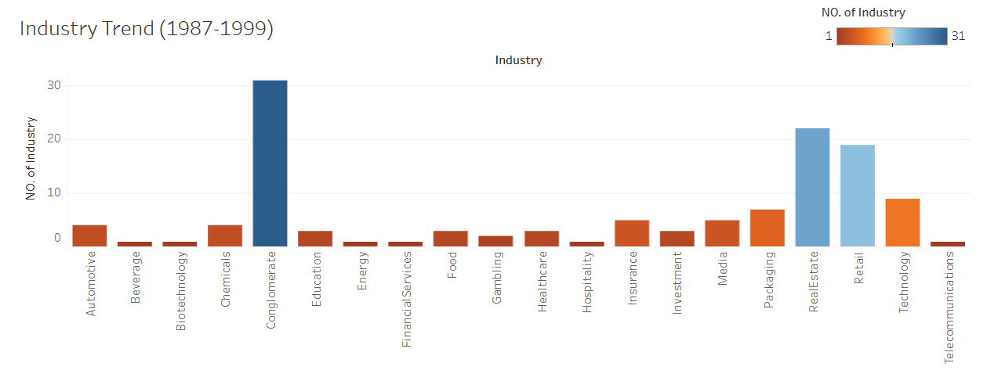
1) Industry Trend(1987-1999)
Conglomerate had the highest number of industries.
Real Estate is second and Retail is third.

Slide 14
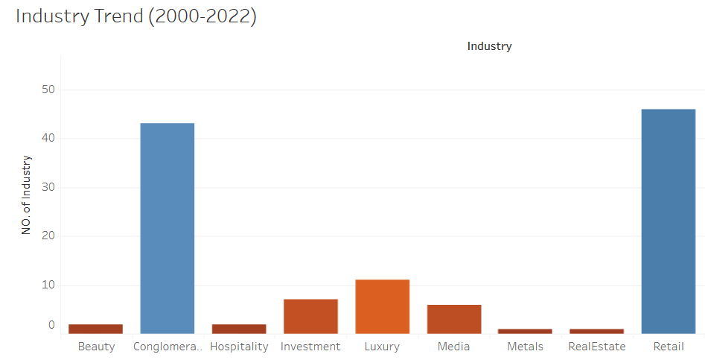
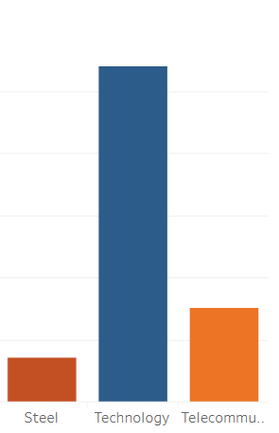
2) Industry Trend(2000-2022)
Technology had the highest number of industries.
Retail is second and Conglomerate is third.

Slide 15
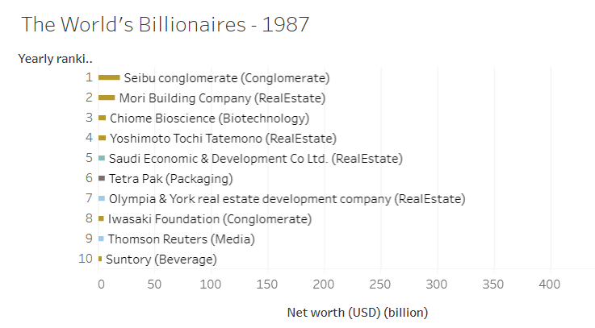
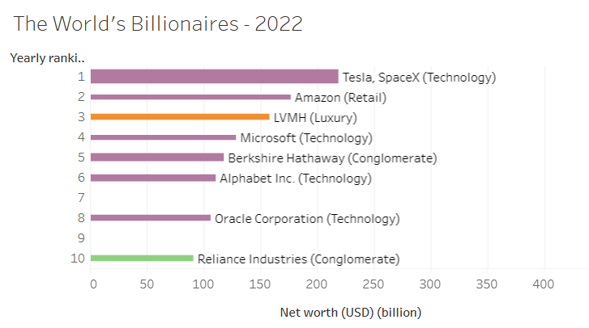
3) The World’s Billionaires-1987
4) The World’s Billionaires-2020
Seibu Conglomerate had the highest net worth in 1987.
Tesla, Space X had the highest net worth in 2022.

Slide 16
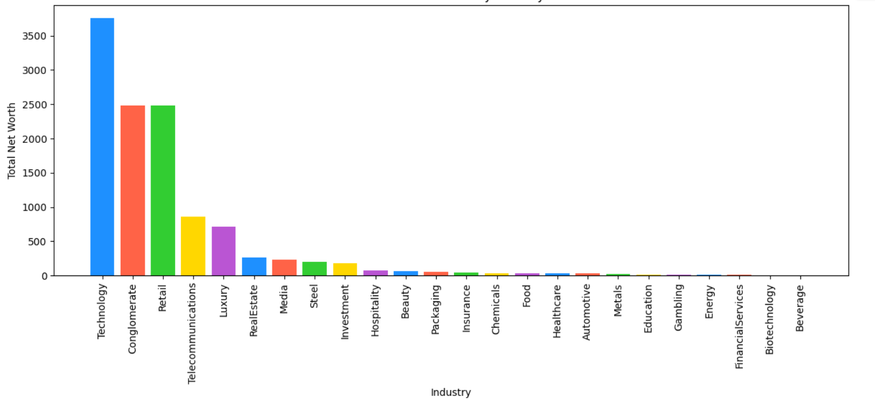
5) Wealth Distribution by Industry
Technology is the dominant Industry with highest net worth.
Beverage has the least Net worth.

Slide 17
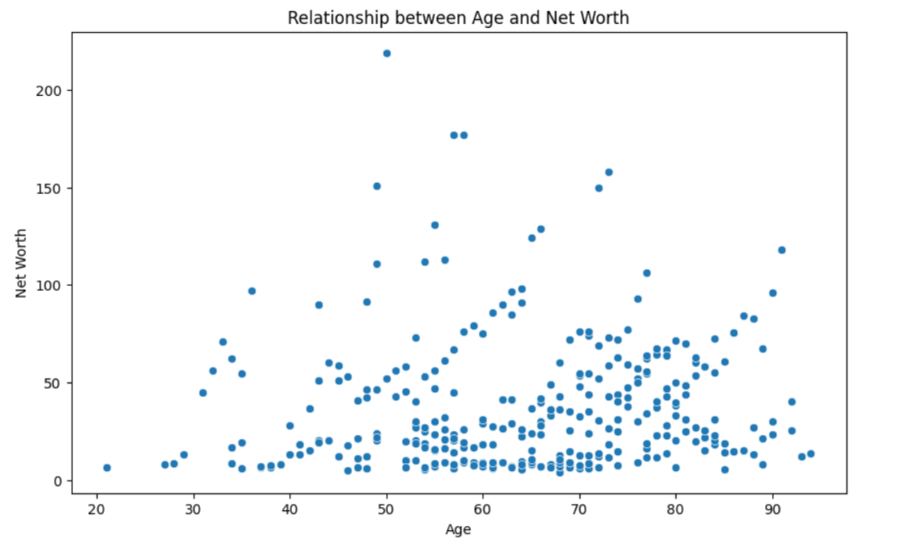
6) Relationship Between Age and Net Worth
Between Age group 50-70, Net worth is high.
Between Age group 50-80, population is high.
We can observe only 4 Industries in the age group 20-30.

Slide 18
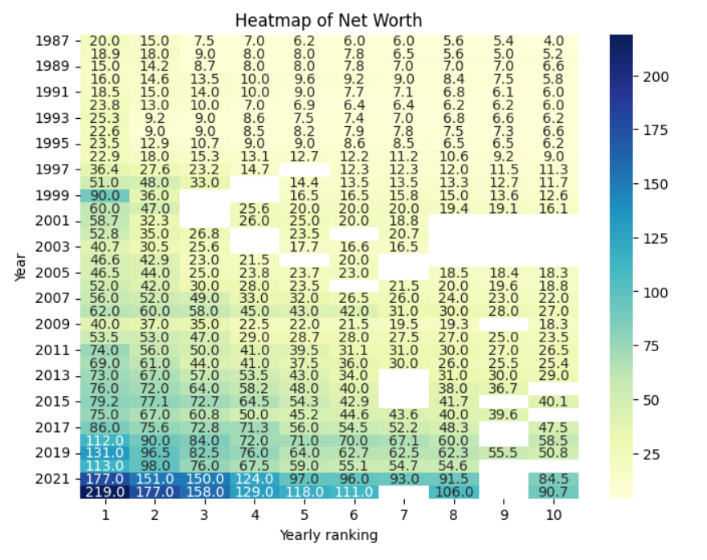
7) Heat map of Net Worth
2022 had more Net worth than in previous years.
In 1999, Net worth of the 1st ranked industry was 90 but later it decreased.

Slide 19
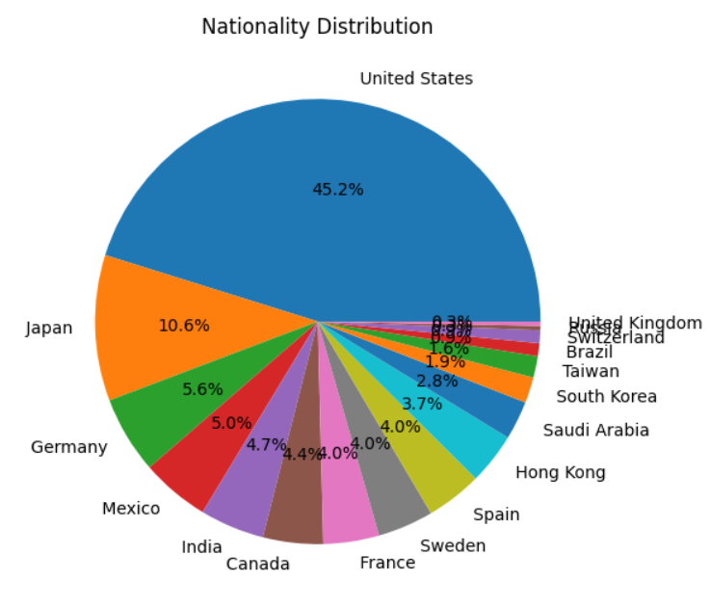
8) Nationality Distribution
United States has the highest number of Industries.
United Kingdom has the least number of Industries.

Slide 20
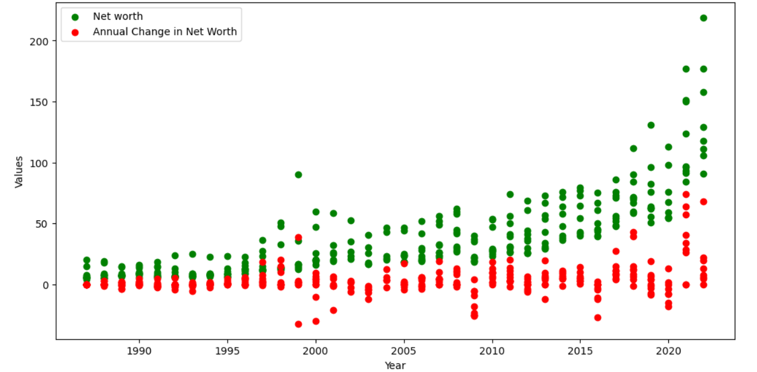
9) Relationship between Year, Networth, and Annual Change in NetWorth
Net Worth increased with Increase in year.
Annual change in Net worth was almost 0.

Slide 21
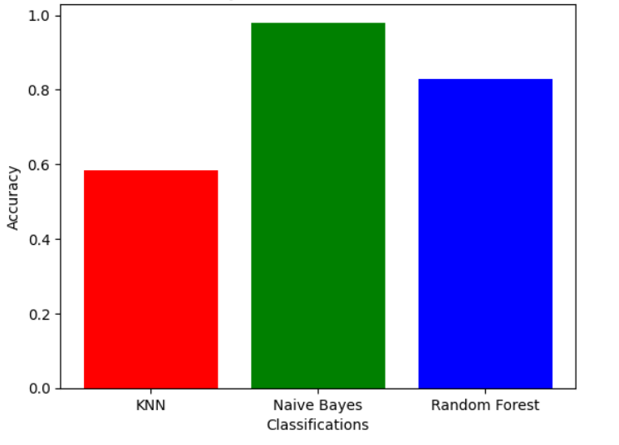
Accuracy for different Classifications
By using Classifications, Naïve Bayes has the highest accuracy.

Slide 22
Conclusion
From the above Analysis we conclude that Technology is the leading Industry. Investing in Technology industry would be profitable. Beverage is a lagging Industry. Between Age group 50-70, Net worth is high. United States has the highest number of Industries. Conglomerate had the highest number of industries. Net Worth increased with Increase in year.

Slide 23
References
https://www.kaggle.com/datasets/earljohnmasaga/leading-industries-dataset
"Exploratory Data Analysis" by John W. Tukey Addison-Wesley, 1977. ISBN: 978-0201076165

Slide 24
Thank You

